Slide 1
Movie Dataset Analysis
Advance SQL Project
Name : Yahavarshini E
Date : 03-03-2025
Course : DA & DS
Batch Name : Dec Regular offline - RP33

Slide 2
Project Objective
Exploring trends
Ratings and Patterns in movies
Provide actionable business insights
Goals
Reinforces SQL concepts: Joins, aggregation, filtering, and grouping.
Extracts insights: Analyzing a real-world movie dataset.

Slide 3
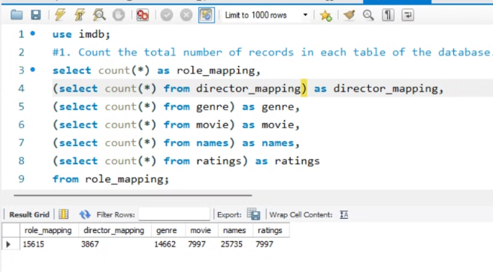
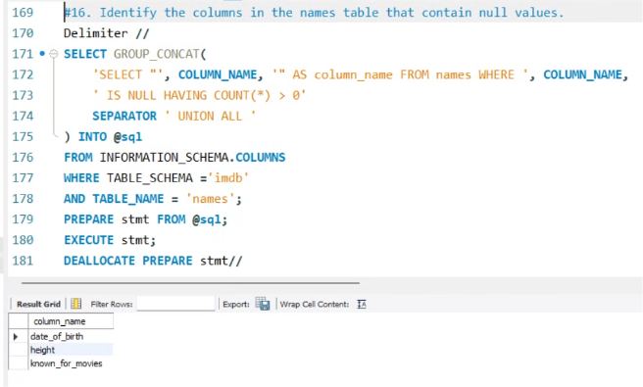
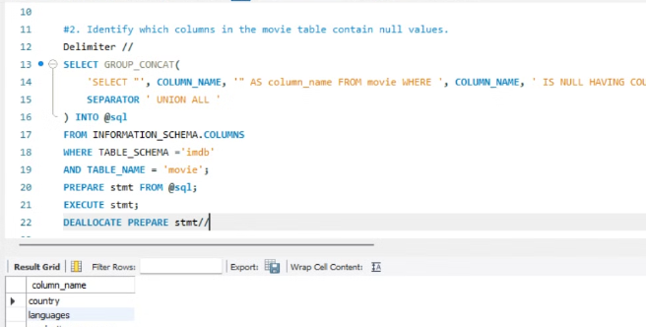
Dataset Overview
Dataset Overview: Contains tables like movies, ratings, actors, and genres.
Stored Information: Includes movie titles, release years, genres, and ratings.
Purpose: Analyze movie trends, audience preferences, and top-rated films.

Slide 4
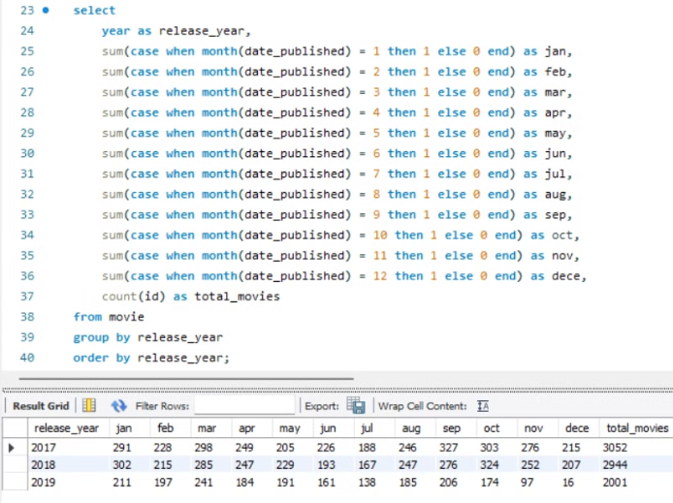
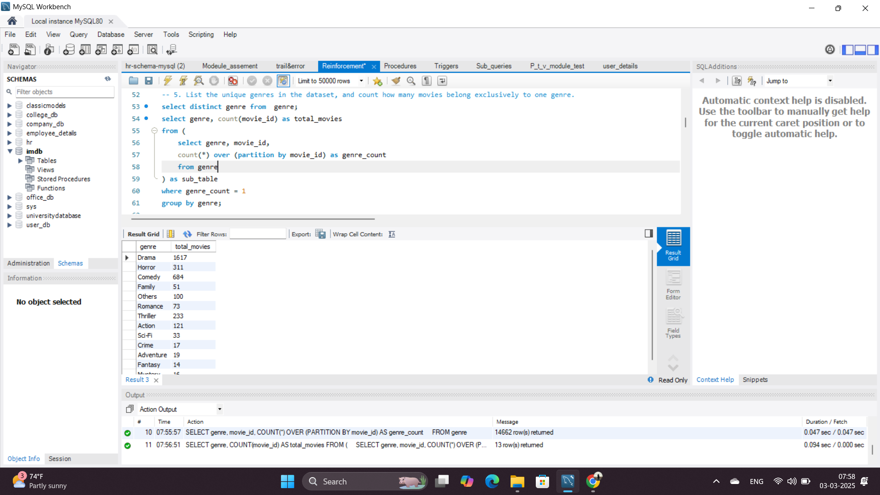
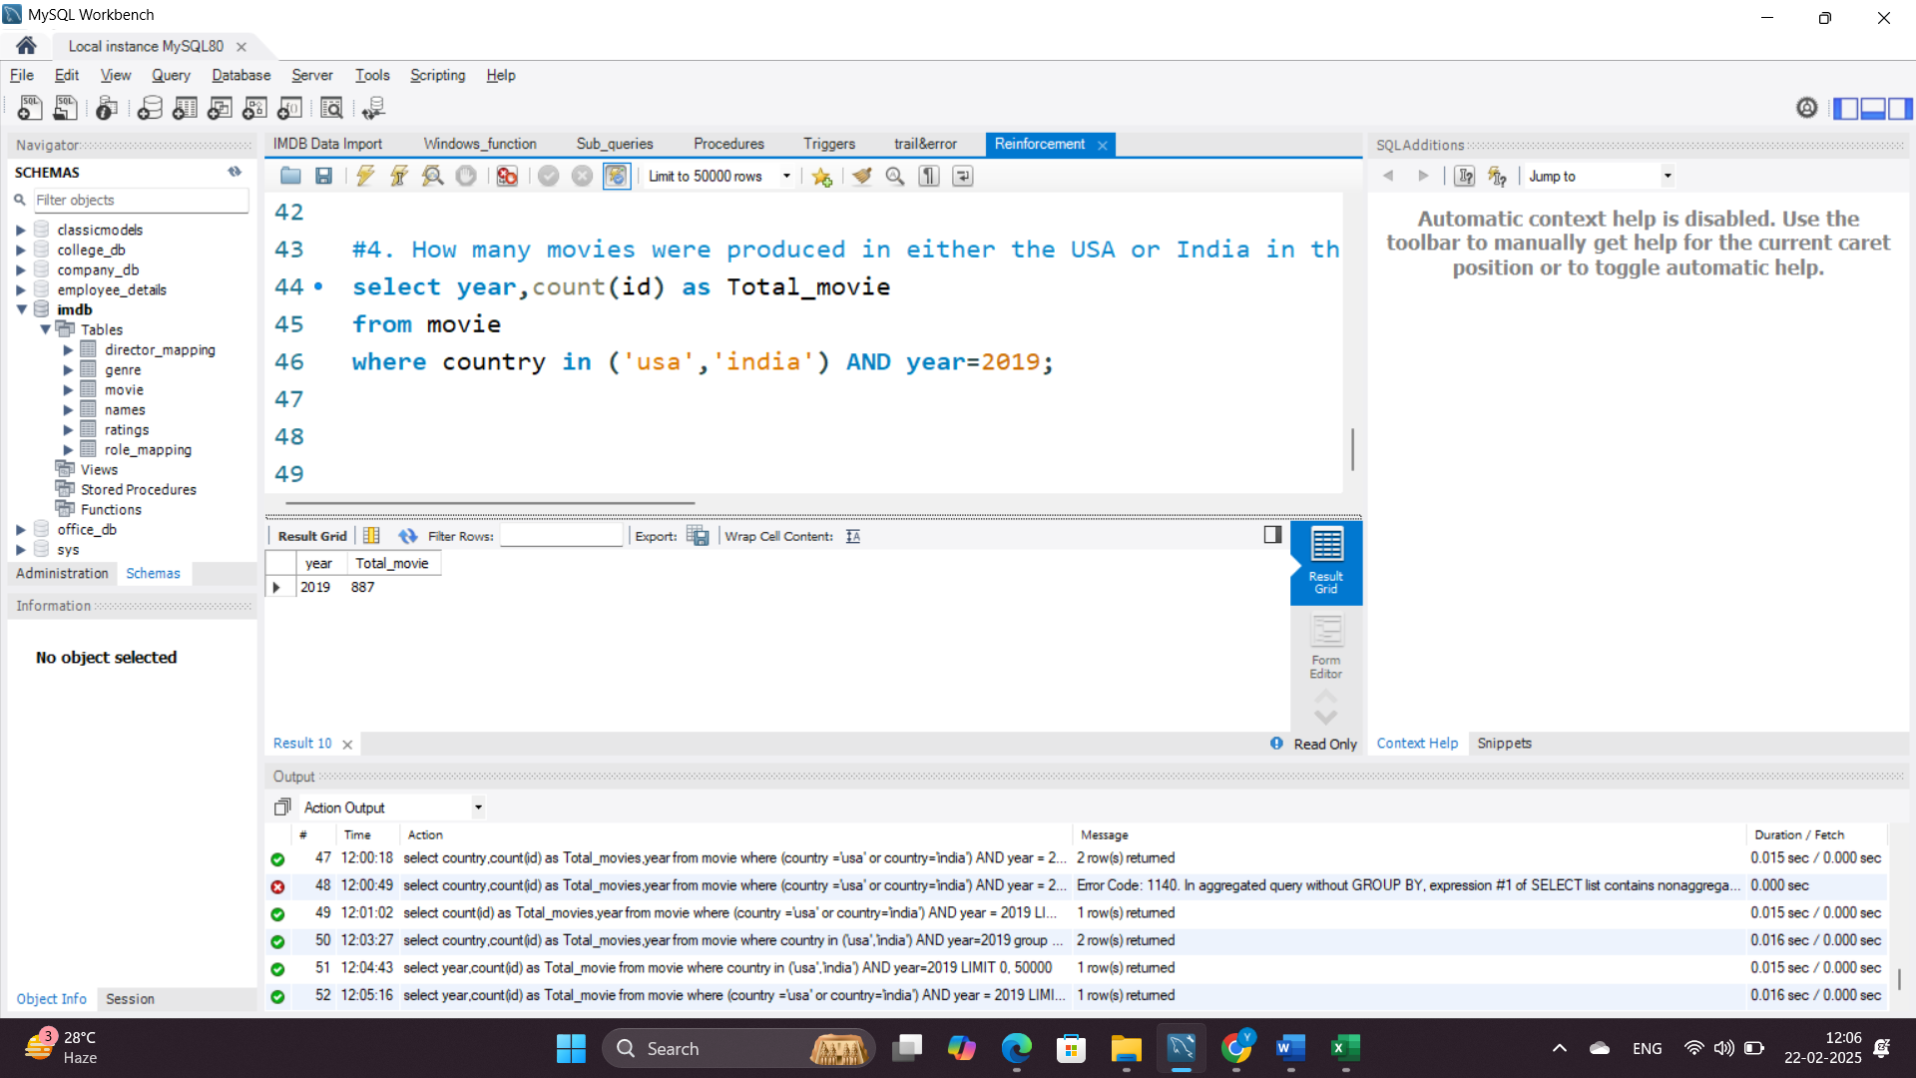
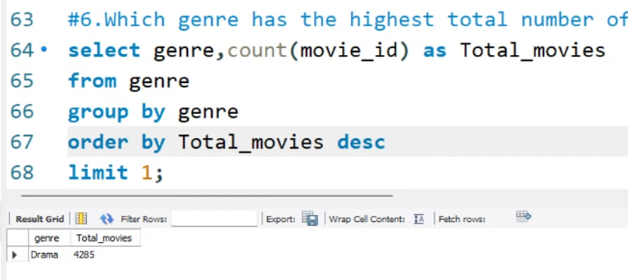
Trends in Movie Production
Insight
Movie production peaks during certain periods due to industry trends or global events
Number of movies per year/month
USA & India were top producers in 2019
Most produced genres: Drama, Action

Slide 5
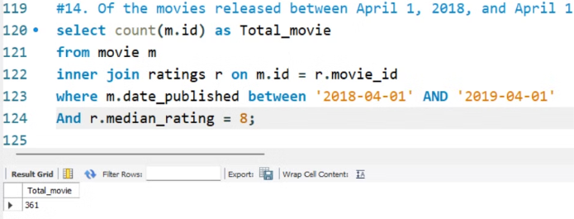
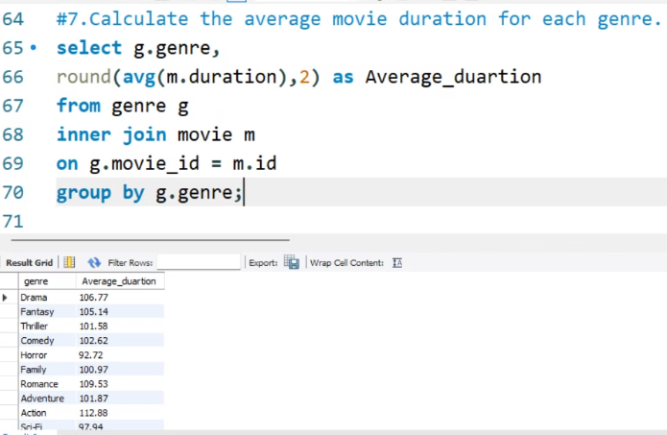
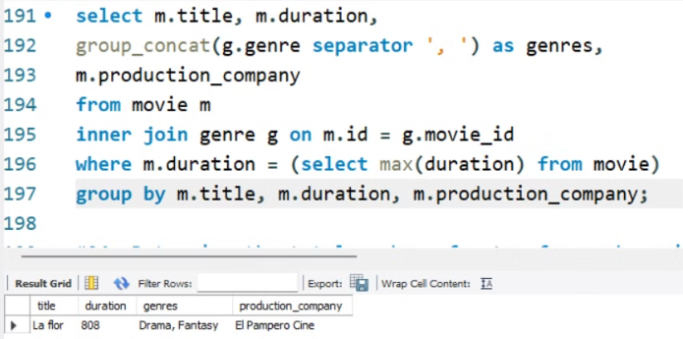
Movie Duration And Performance Analysis
Insights
Different genres have different durations, influencing audience engagement
Highlights the number of critically well-received movies within the timeframe.

Slide 6
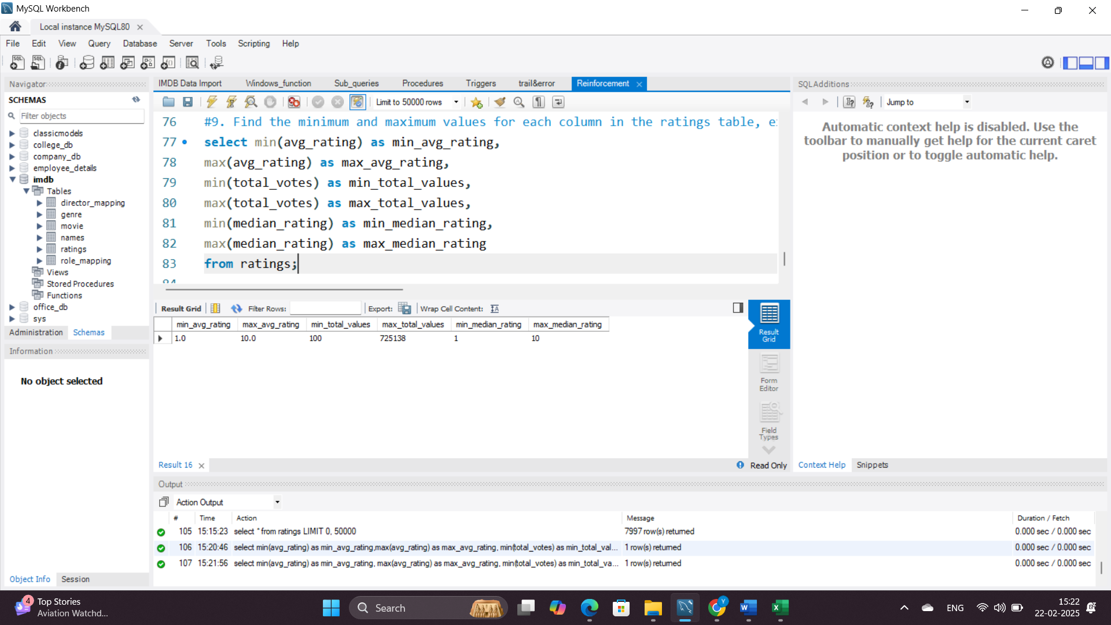
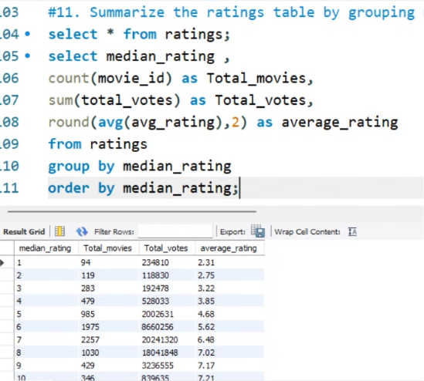
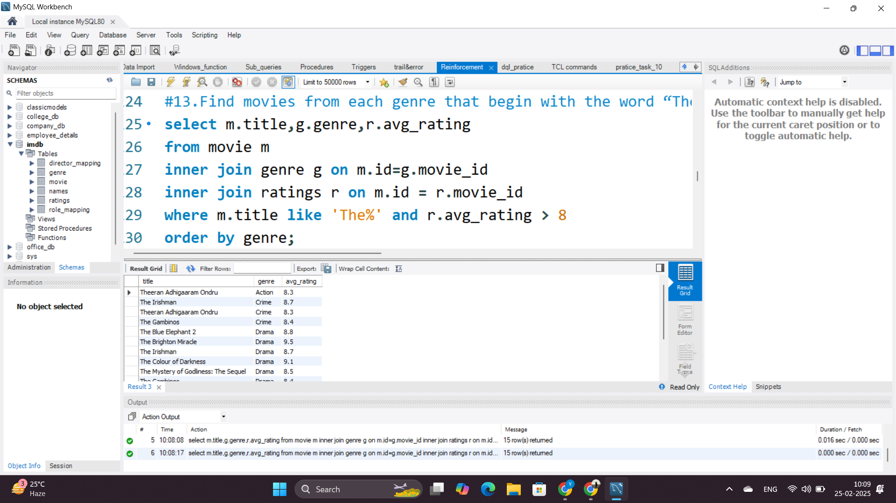
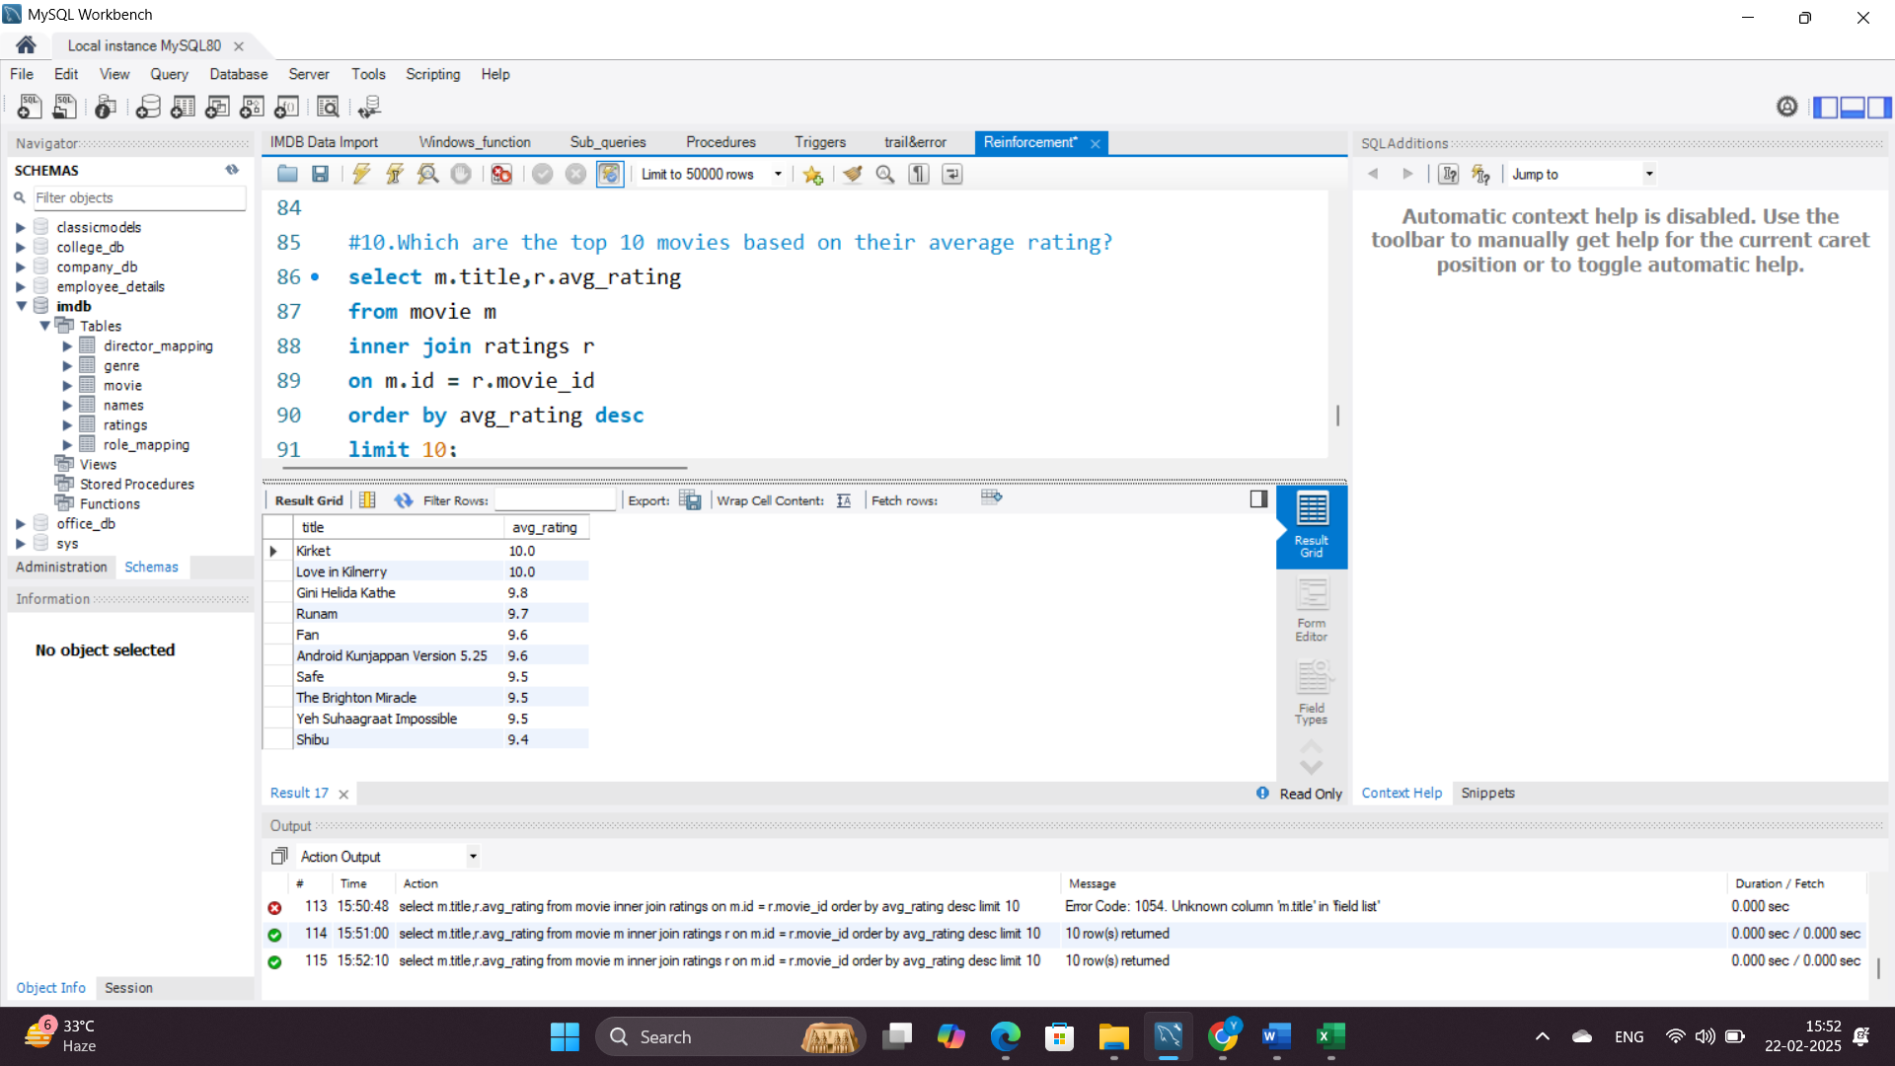
Movie Ratings And Trends
Insights
Highly rated movies tend to have strong storylines or big-name actors.
Seasonal trends - Certain months might have higher ratings
due to award seasons.

Slide 7
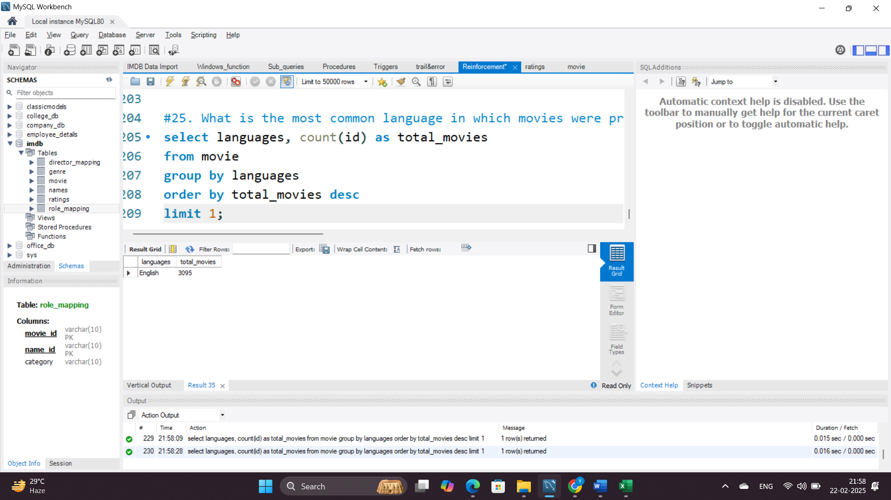
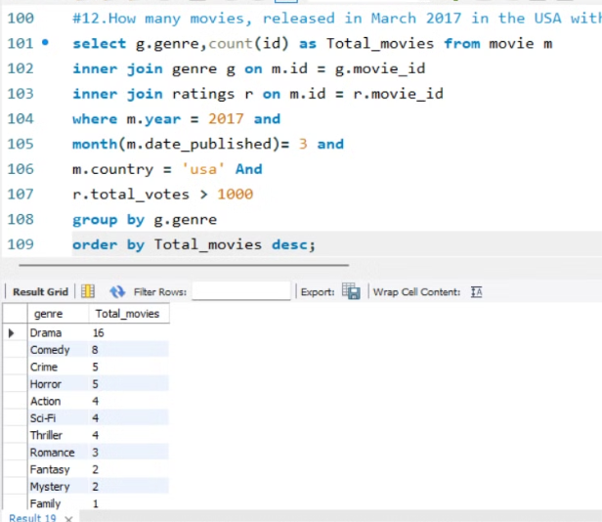
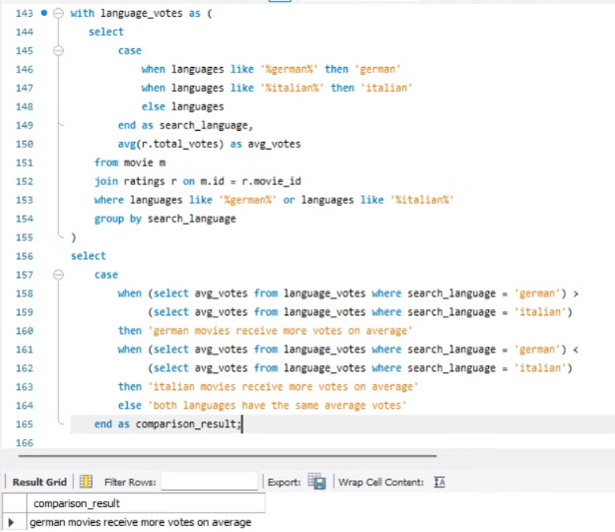
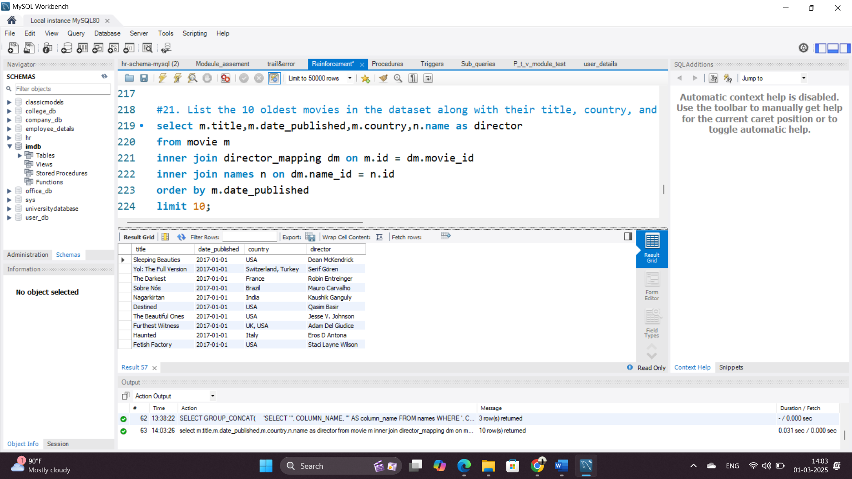
Movie Popularity Trends
Insights
Drama led with 16 movies over 1,000 votes.
German movies received more votes on average than Italian.

Slide 8
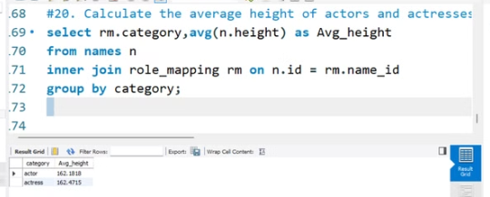
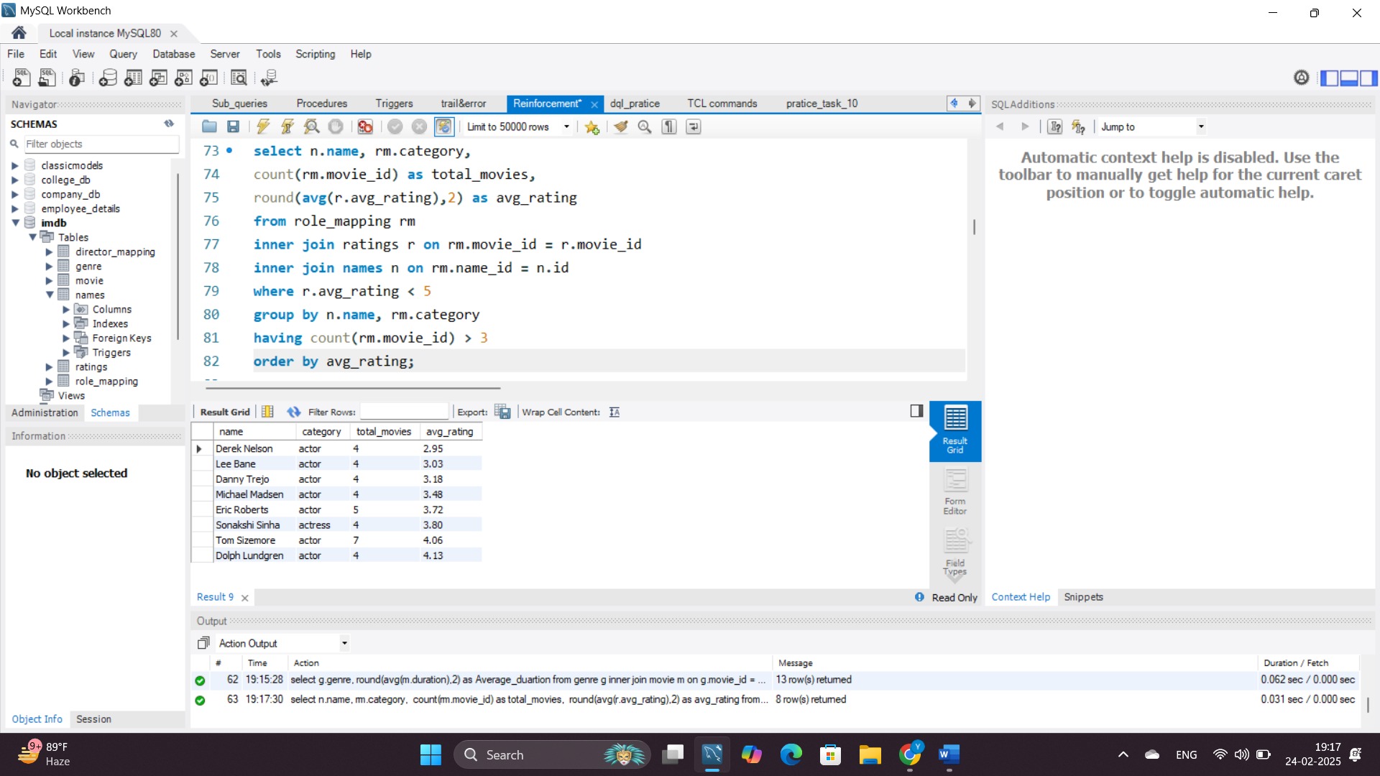
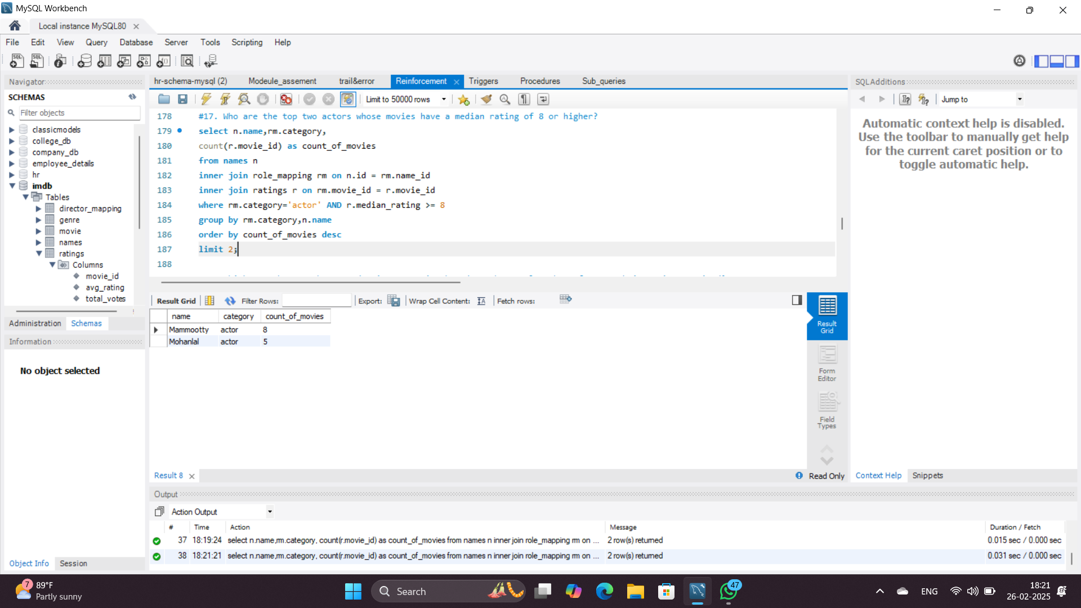
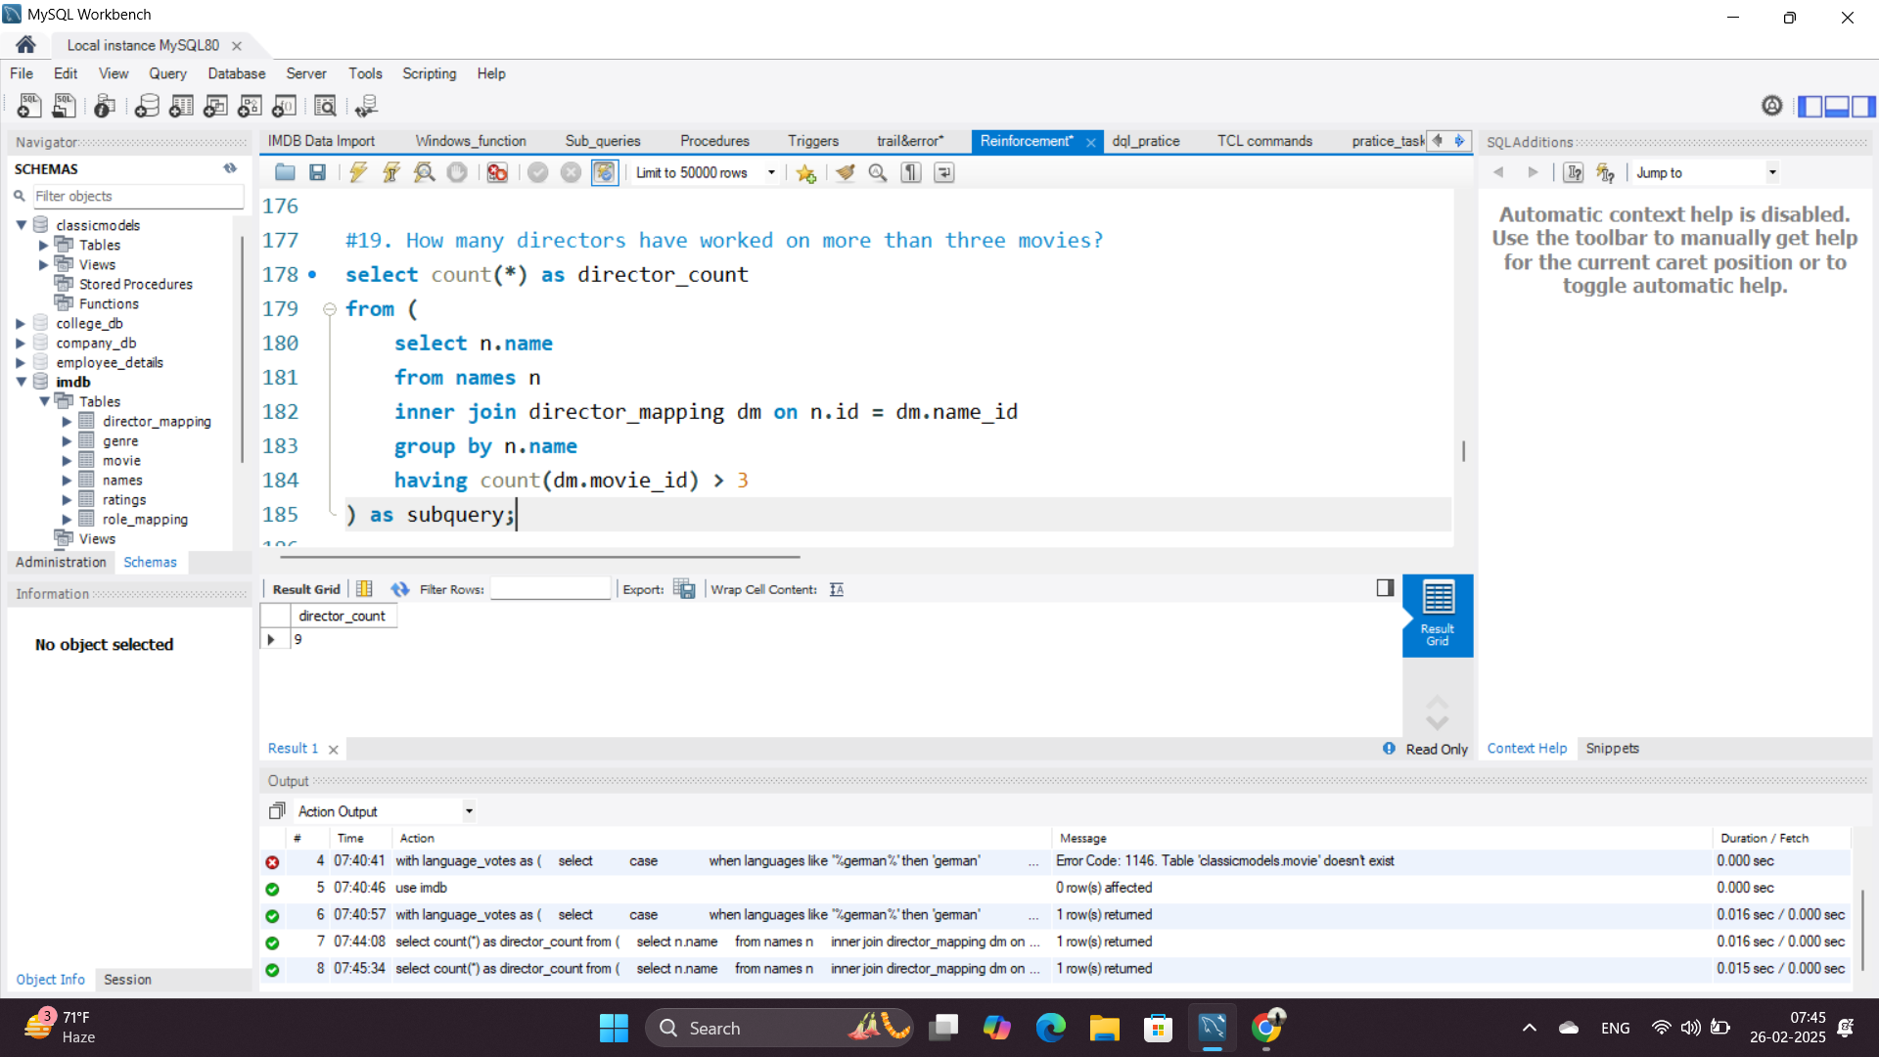
Actor And Director Performance
Insights
Some actors are box office stars, while others are typecast into bad movies.
Director consistency impacts ratings.

Slide 9
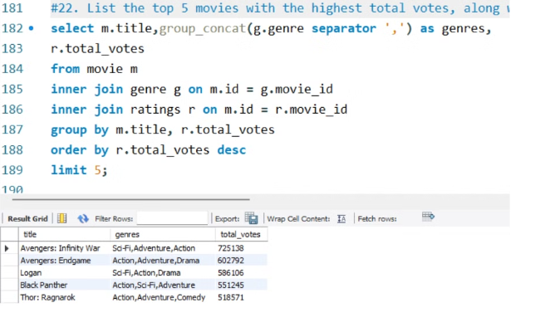
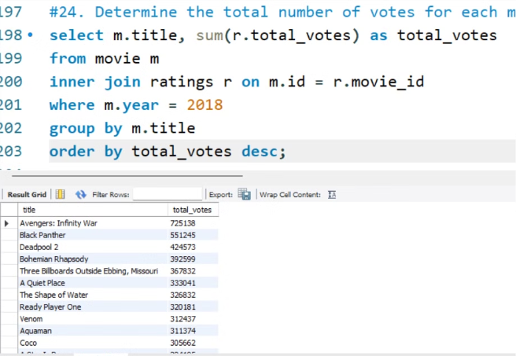
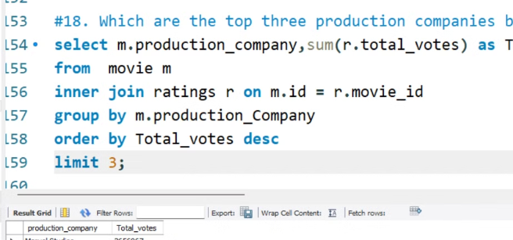
Audience Engagement
Insights
Higher votes ≠ higher ratings; some movies are controversial but widely discussed

Slide 10
Key Insights
Movie Trends: Certain genres dominate production, but top-rated movies vary
Audience Preferences: High-rated movies tend to have strong actors & directors
Industry Insights: Large studios get more votes, but indie films may have better ratings
Engagement Trends: Certain countries get more votes due to larger audiences
Conclusion
Audience choices shape movies—knowing trends improves storytelling.
Data helps filmmakers meet audience needs.
Movie success depends on more than release dates—engagement and genre matter.

Slide 11

Any Questions?
Thank You

